Slide 1


Slide 2
TO
CAMPUS TRAINING AND PLACEMENT CELL MANAGEMENT SYSTEM
CREATED BY:
MR.NANAVARE PRATIK DINKAR
UNDER THE GUIDANCE OF
PROF.PONDKULE S.N

Slide 3
INDEX
INTRODUCTION
SCOPE OF SYSTEM
PURPOSE OF SYSTEM
OBJECTIVE
FACT FINDING TECHNIQUES
FEASIBILITY STUDY
DIAGRAMS
USER INTERFACE
TABLES
ADVANTAGES AND DISADVANTAGES
FUTURE SCOPE
CONCLUSION

Slide 4
INRODUCTION
In today's competitive job market, the role of campus training and placement cells within educational institutions has become increasingly vital. These cells serve as intermediaries between students seeking employment opportunities and companies looking to recruit fresh talent. However, managing the multitude of tasks involved in the placement process can be complex and time-consuming. To address these challenges, the Campus Training and Placement Cell Management System (CTPCMS) offers a comprehensive solution.

Slide 5
SCOPE OF SYSTEM
The scope of the Campus Training and Placement Cell Management System (CTPCMS) encompasses various aspects of managing campus placement activities within educational institutions. The system aims to address the needs of students, placement coordinators, recruiters, and administrators involved in the placement process. The key components within the scope of CTPCMS include:
1.Student Management
2.Job Posting and Management
3.Placement Tracking
4.Communication And Collebration

Slide 6
PURPOSE OF SYSTEM
The purpose of developing the Campus Training and Placement Cell Management System (CTPCMS) is multifaceted and encompasses several key objectives:
Streamline Placement Process:CTPCMS aims to streamline the various processes involved in managing campus placements, including job posting, application processing, and placement tracking.
Optimize Decision Making:By leveraging data analytics and reporting capabilities, CTPCMS enables placement coordinators and administrators to make data-driven decisions to optimize the placement process.
Empower Student:CTPCMS empowers students by providing them with the tools and resources they need to enhance their employability and secure meaningful employment opportunities.
Strengthen Industry Connections:CTPCMS strengthens the connection between educational institutions and the industry by facilitating connections between students and recruiters.

Slide 7
OBJECTIVE OF SYSTEM
The objective of the Campus Training and Placement Cell Management System (CTPCMS) is to create a comprehensive software solution that facilitates the efficient management of campus placement activities within educational institutions. The primary objectives of CTPCMS include:
Automation
Transparency
Communication
Empowerment

Slide 8
Fact Finding Techniques
Fact-finding techniques are methods used to gather information, requirements, and insights from stakeholders, users, and other sources to understand the current situation, identify needs, and inform decision-making in the context of software development projects. Here are some commonly used fact-finding techniques:
Interviews:
Conducting structured or unstructured interviews with stakeholders, users, subject matter experts, and other relevant parties to gather information, elicit requirements, and understand perspectives. Interviews allow for open-ended discussions and follow-up questions to explore topics in depth.
Questionnaires and Surveys:
Distributing questionnaires or surveys to stakeholders and users to collect data, opinions, preferences, and feedback on specific topics or areas of interest.

Slide 9
Fact Finding Techniques
Observation:
Observing users, processes, and interactions in their natural environment to understand how systems are used, identify pain points, and uncover areas for improvement. Observation can provide valuable insights into user behavior, workflow patterns, and usability issues that may not be apparent through other methods.
Document Analysis:
Reviewing existing documentation, reports, specifications, requirements documents, and other relevant materials to gather information, clarify details, and validate understanding. Document analysis helps identify gaps, inconsistencies, and dependencies that need to be addressed in the software development process.

Slide 10
Feasibility Study
Technical Feasibility:
Assess the technical requirements and capabilities needed to develop, deploy, and maintain CTPCMS.
CTPCMS Evaluate the availability of skilled IT resources,infrastructure and technology platform required for implementing scope.
Determine whether the institutions existing system and platforms can integrate with CTPCMS. .

Slide 11
Feasibility Study
Financial Feasibility:
Estimate the costs associated with developing, customizing, and deploying CTPCMS, including software development, hardware, licensing, and implementation services.
Compare the estimated costs with the expected benefits and potential savings from improved efficiency, reduced manual effort, and enhanced placement outcomes.
Conduct a cost-benefit analysis to determine the return on investment (ROI) and payback period for implementing CTPCMS.

Slide 12
Feasibility Study
Operational Feasibility:
Access the operational impact of implementing CTPCMS on existing process,workflows and stackholders within the educational institution.
Identify potential barriers to adoption,such as resistance to change ,lack of user training or culture factors Compare the estimated costs with the expected benefits and potential savings from improved efficiency, reduced manual effort, and enhanced placement outcomes.
Develop a change management plan to address challanges and ensure the smooth transiction to CTPCMS.

Slide 13
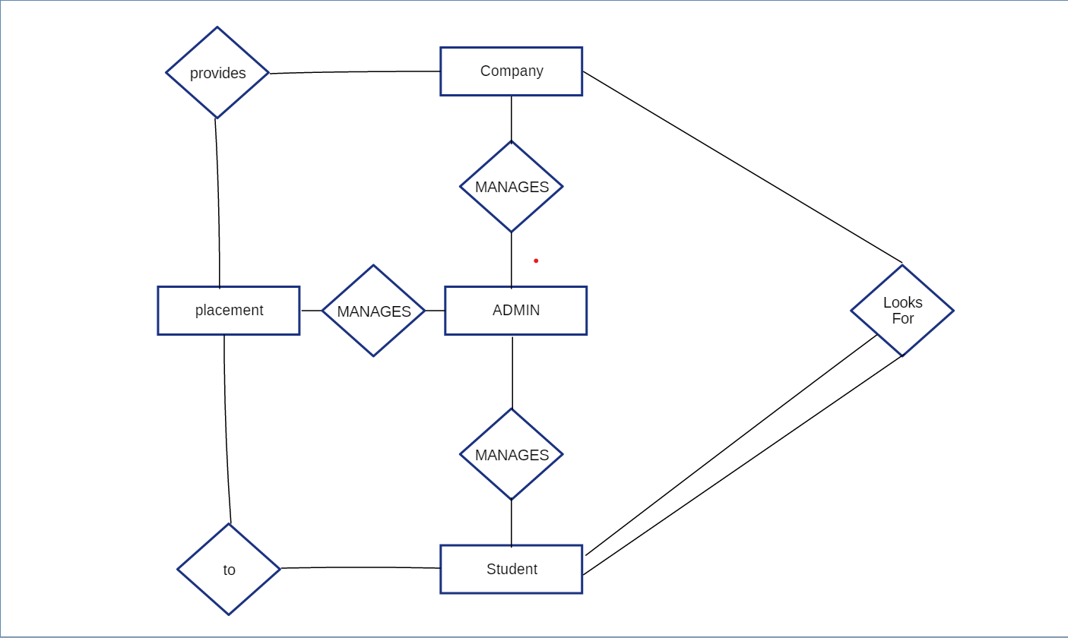
Diagrams ER DIAGRAM

Slide 14
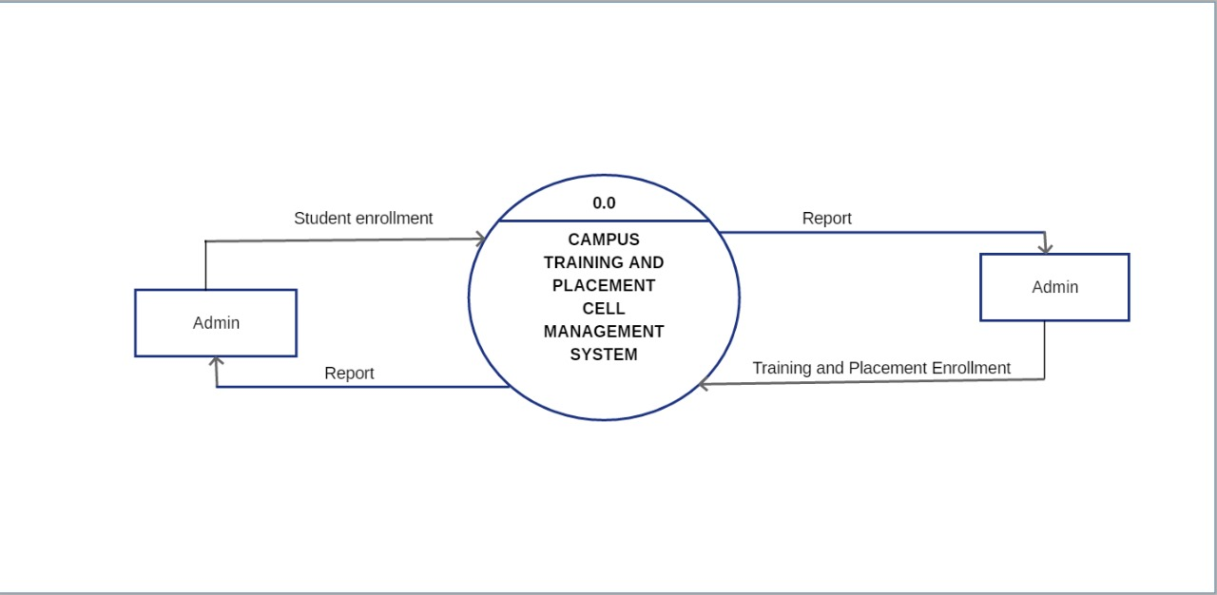
Diagrams CONTEXT LEVEL

Slide 15
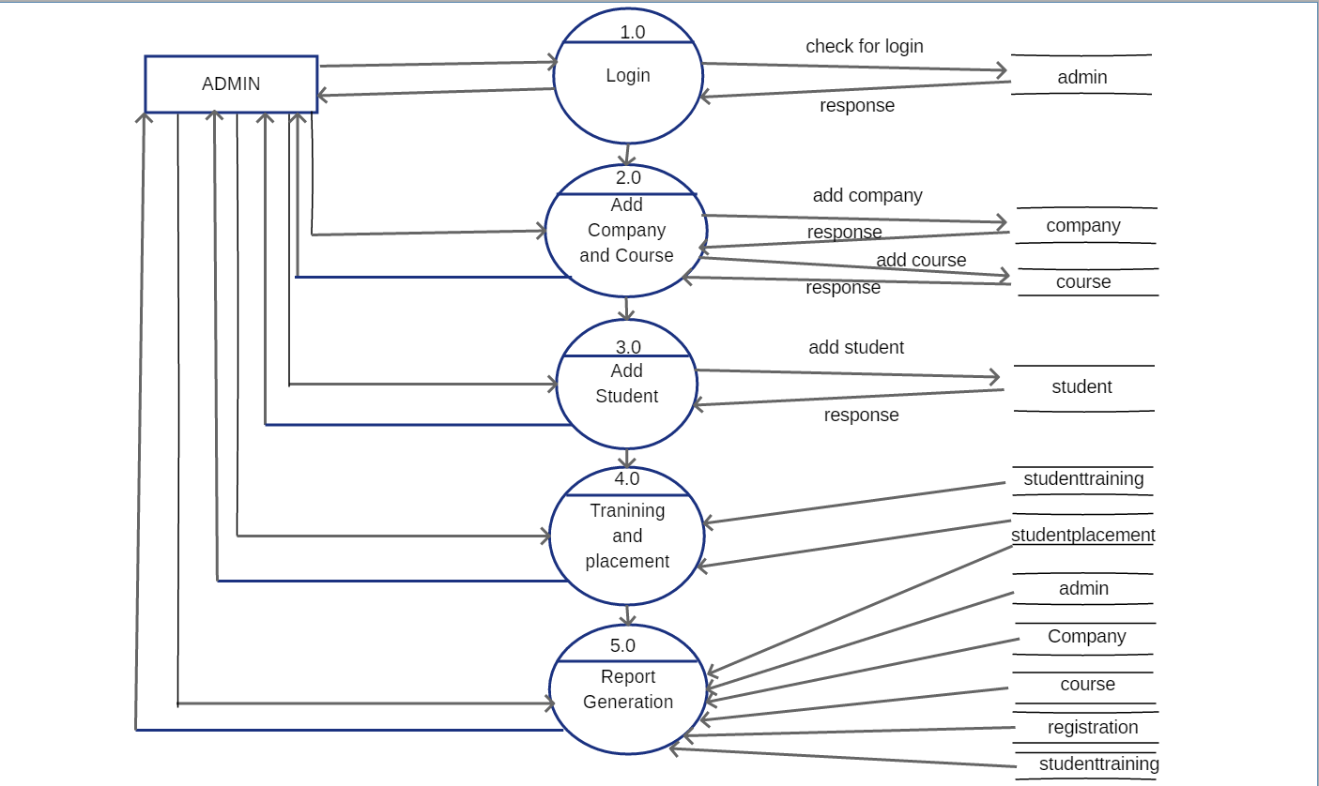
Diagrams FIRST LEVEL DFD

Slide 16
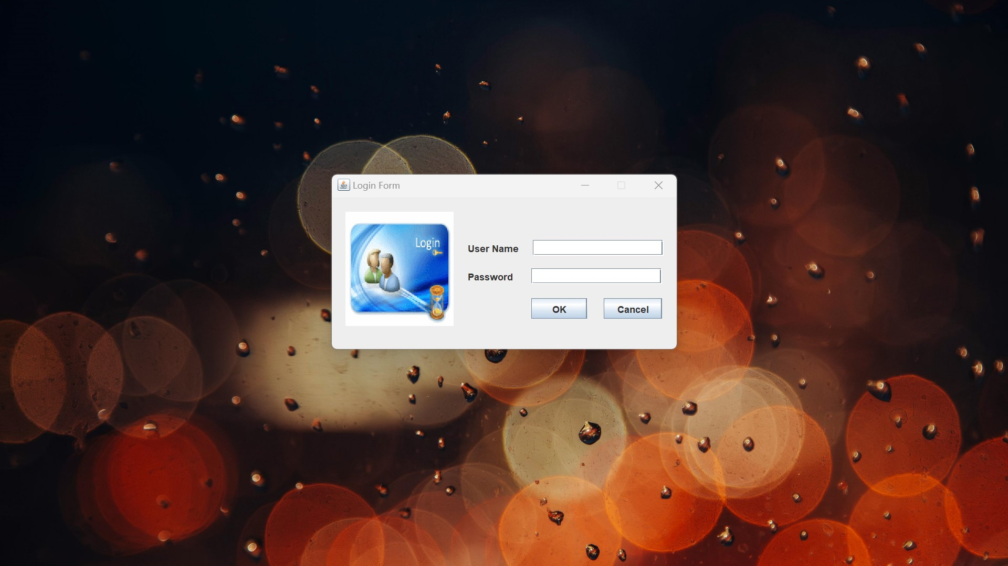
User Interface LOGIN PAGE

Slide 17
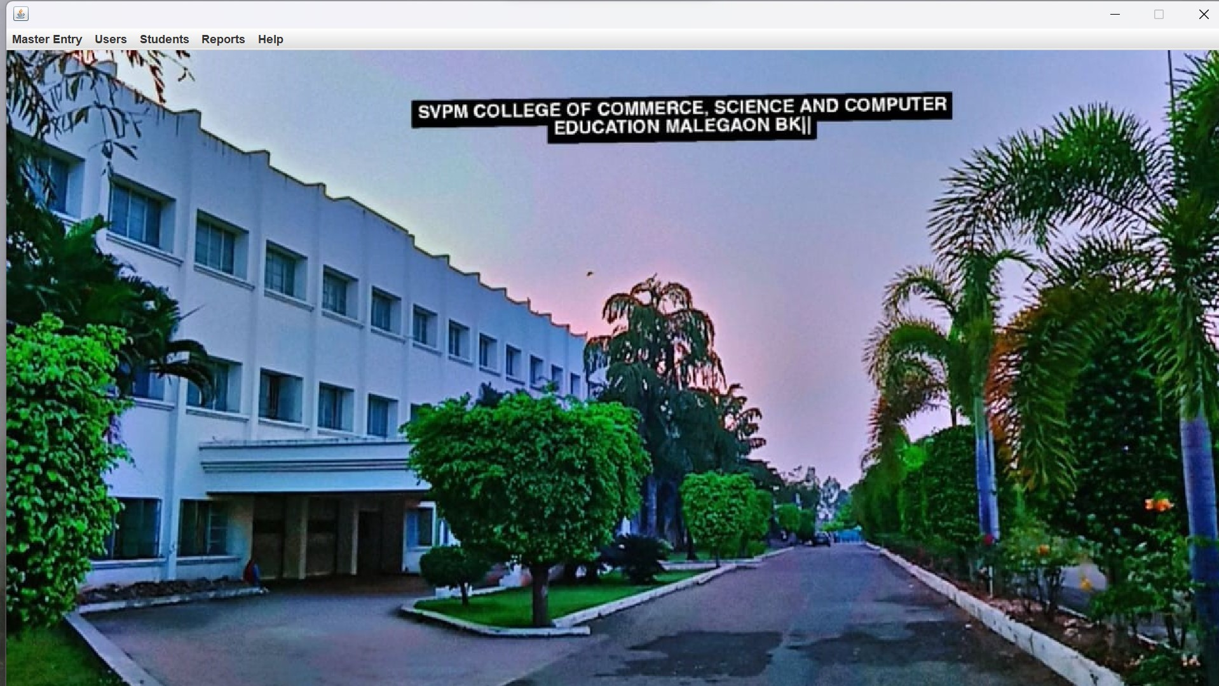
User Interface HOME PAGE

Slide 18
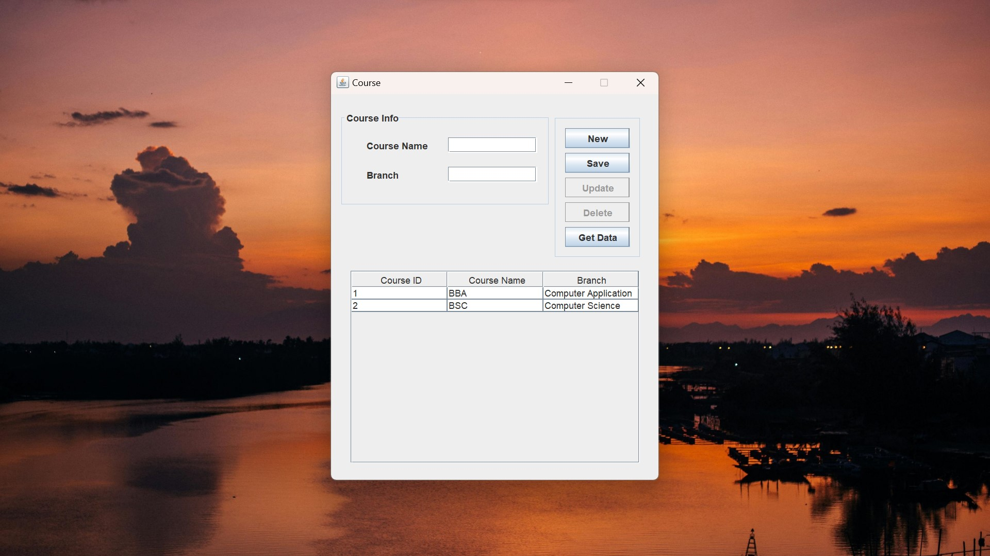
User Interface ADD COURSE

Slide 19
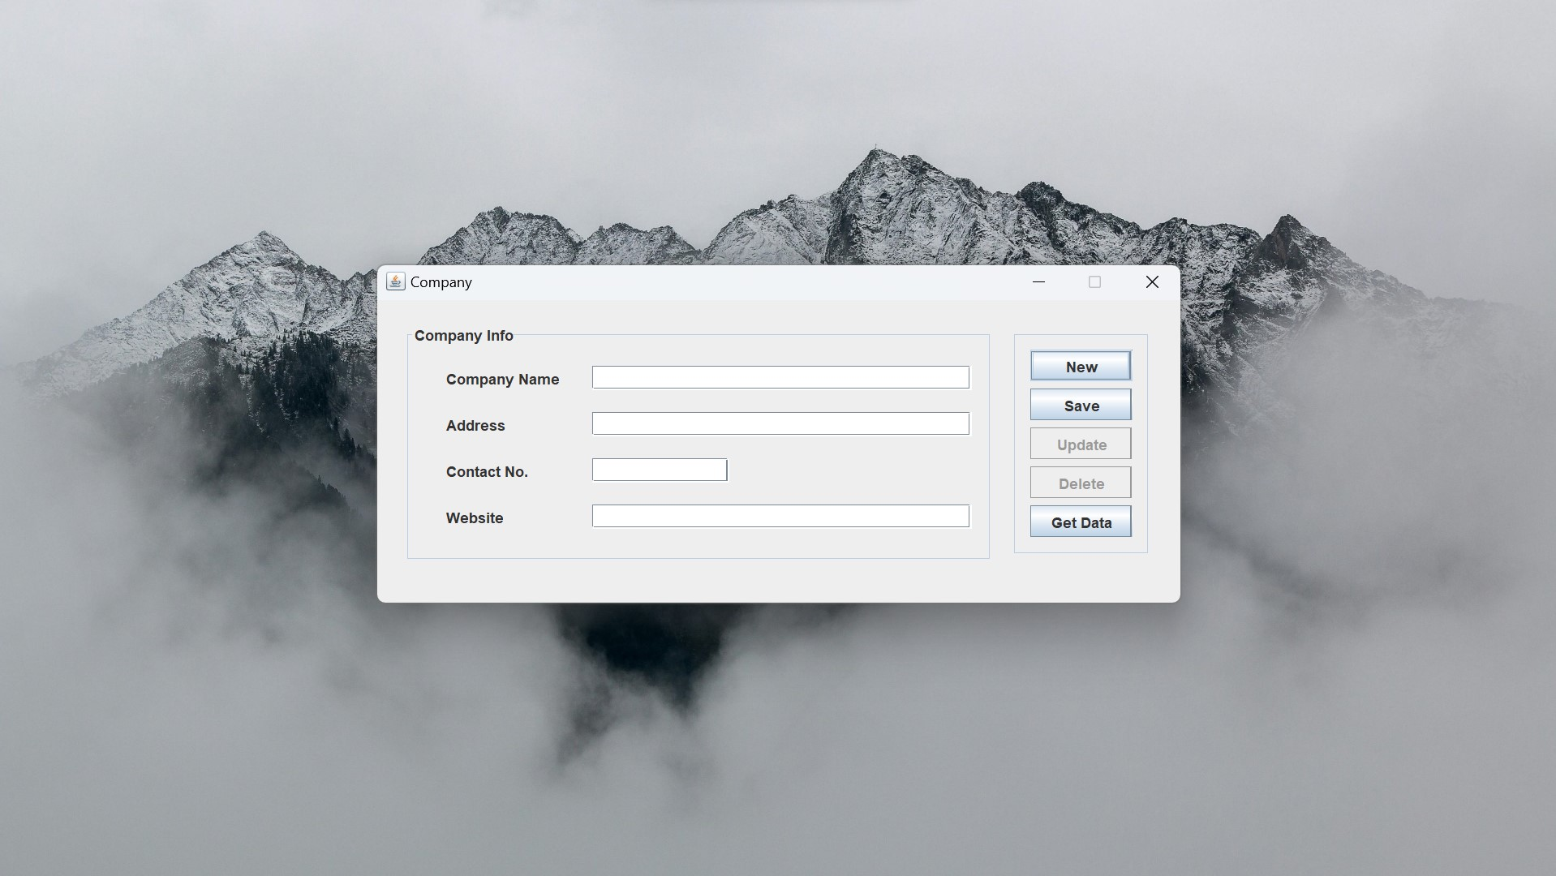
User Interface ADD COMPANY

Slide 20
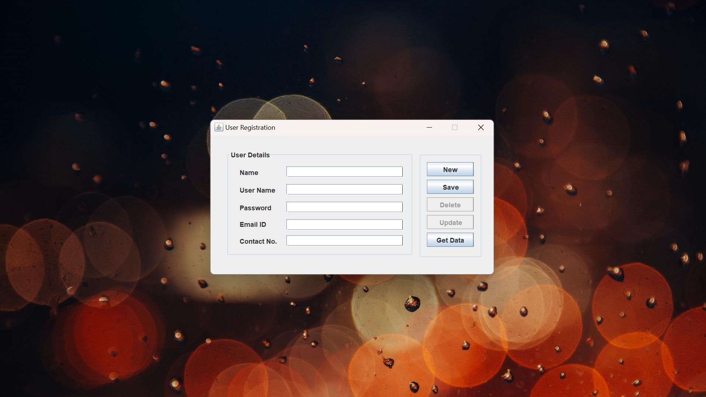
User Interface REGISTRATION PAGE

Slide 21
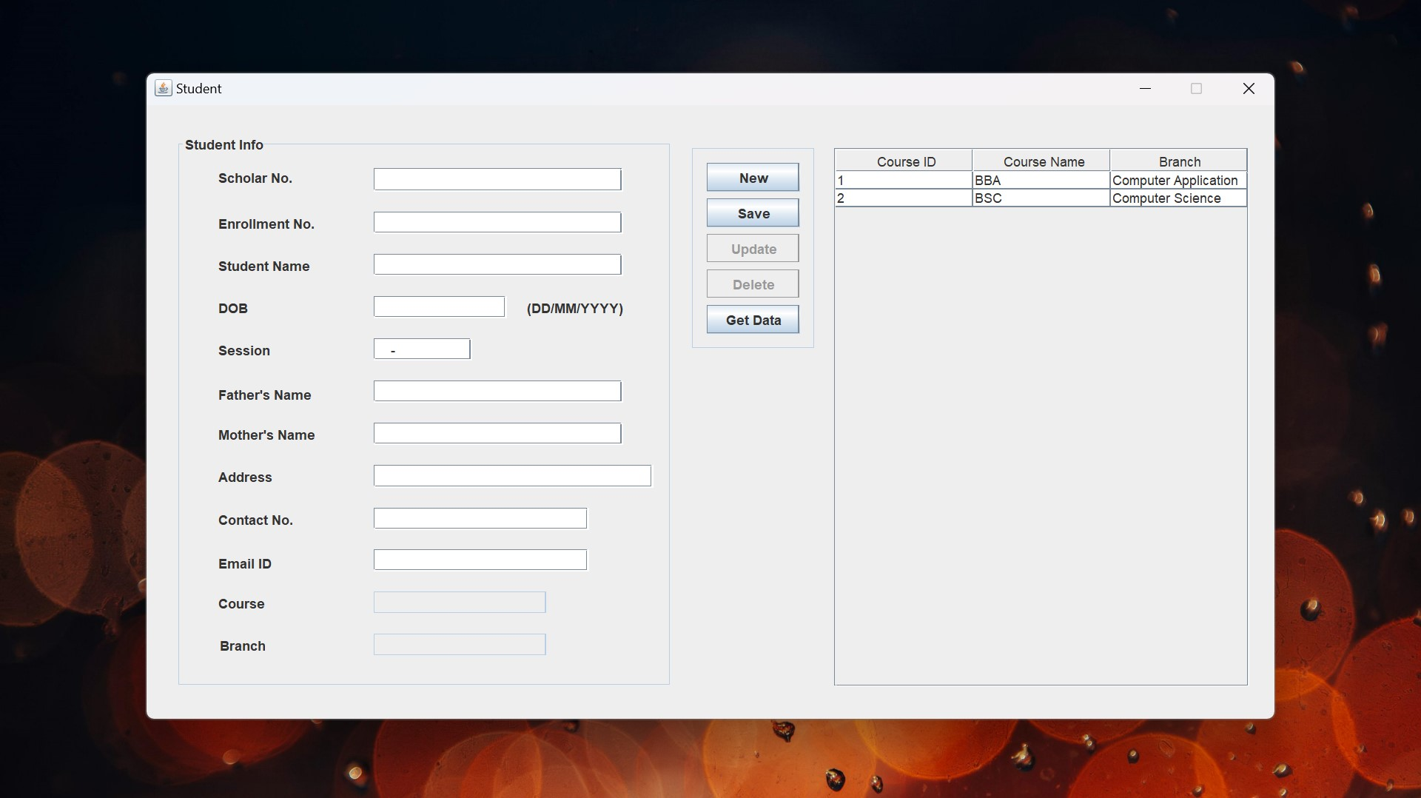
User Interface PROFILE ENTRY PAGE

Slide 22
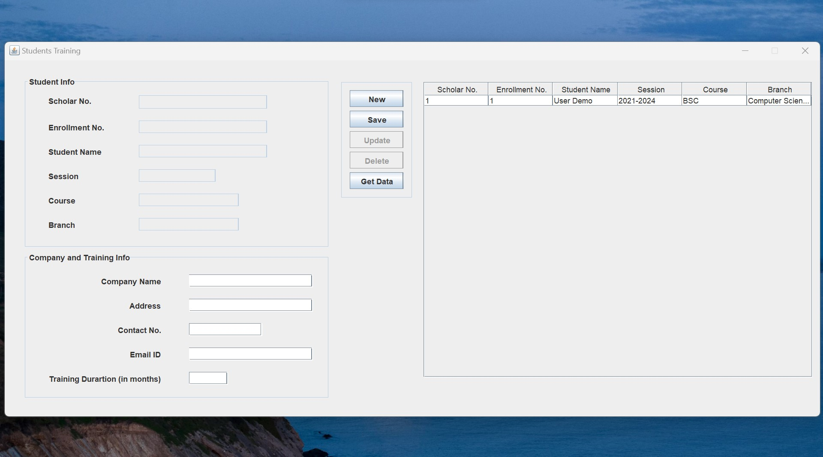
User Interface TRAINING ENTRY PAGE

Slide 23
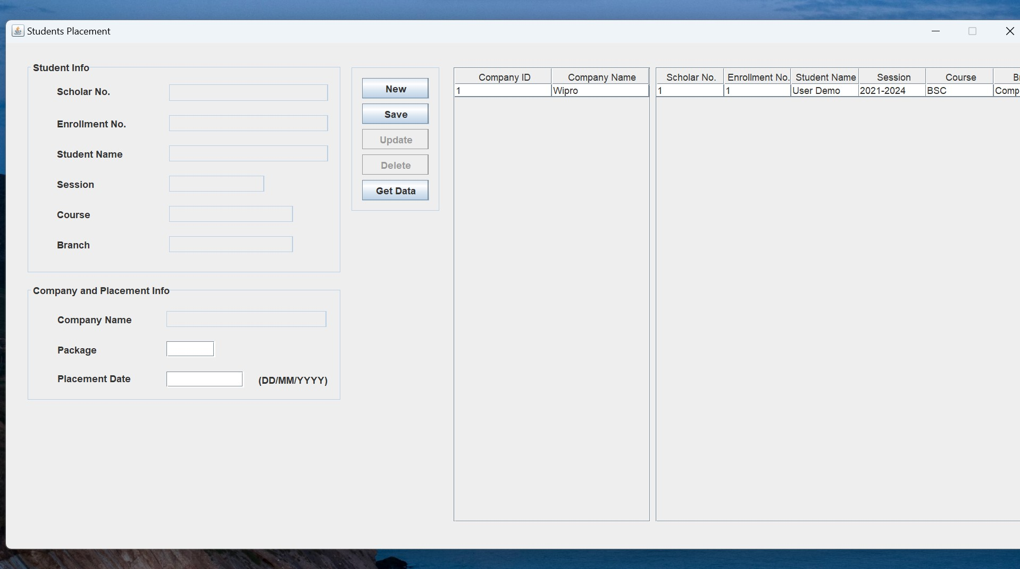
User Interface PLACEMENT ENTRY PAGE

Slide 24
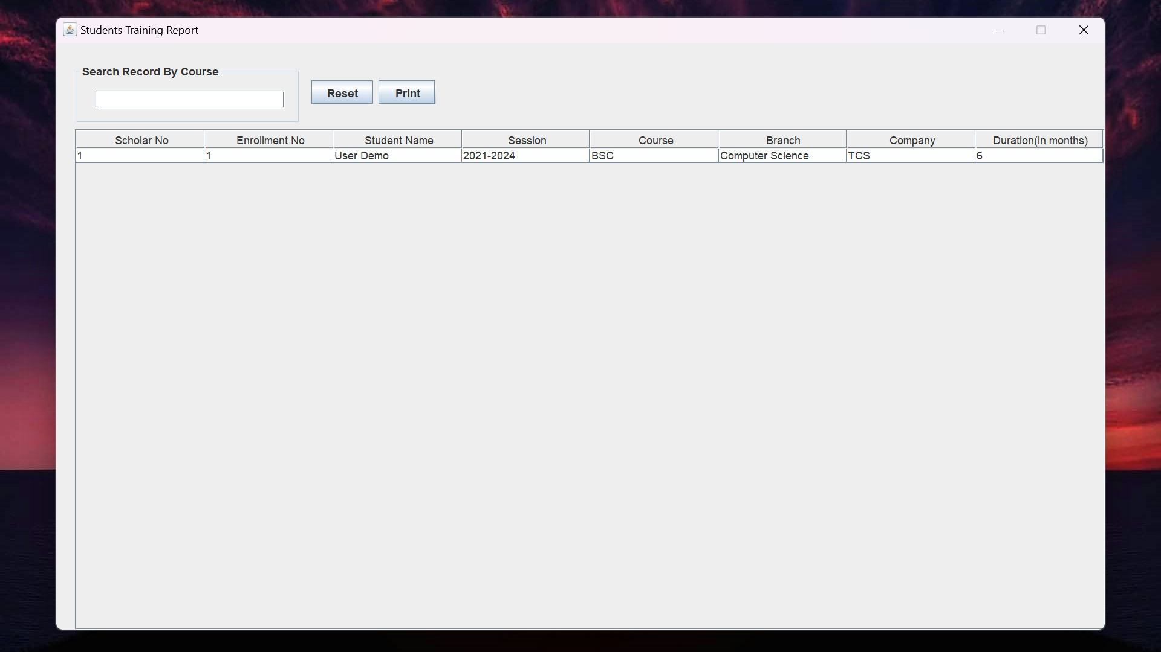
User Interface TRAINING REPORT PAGE

Slide 25
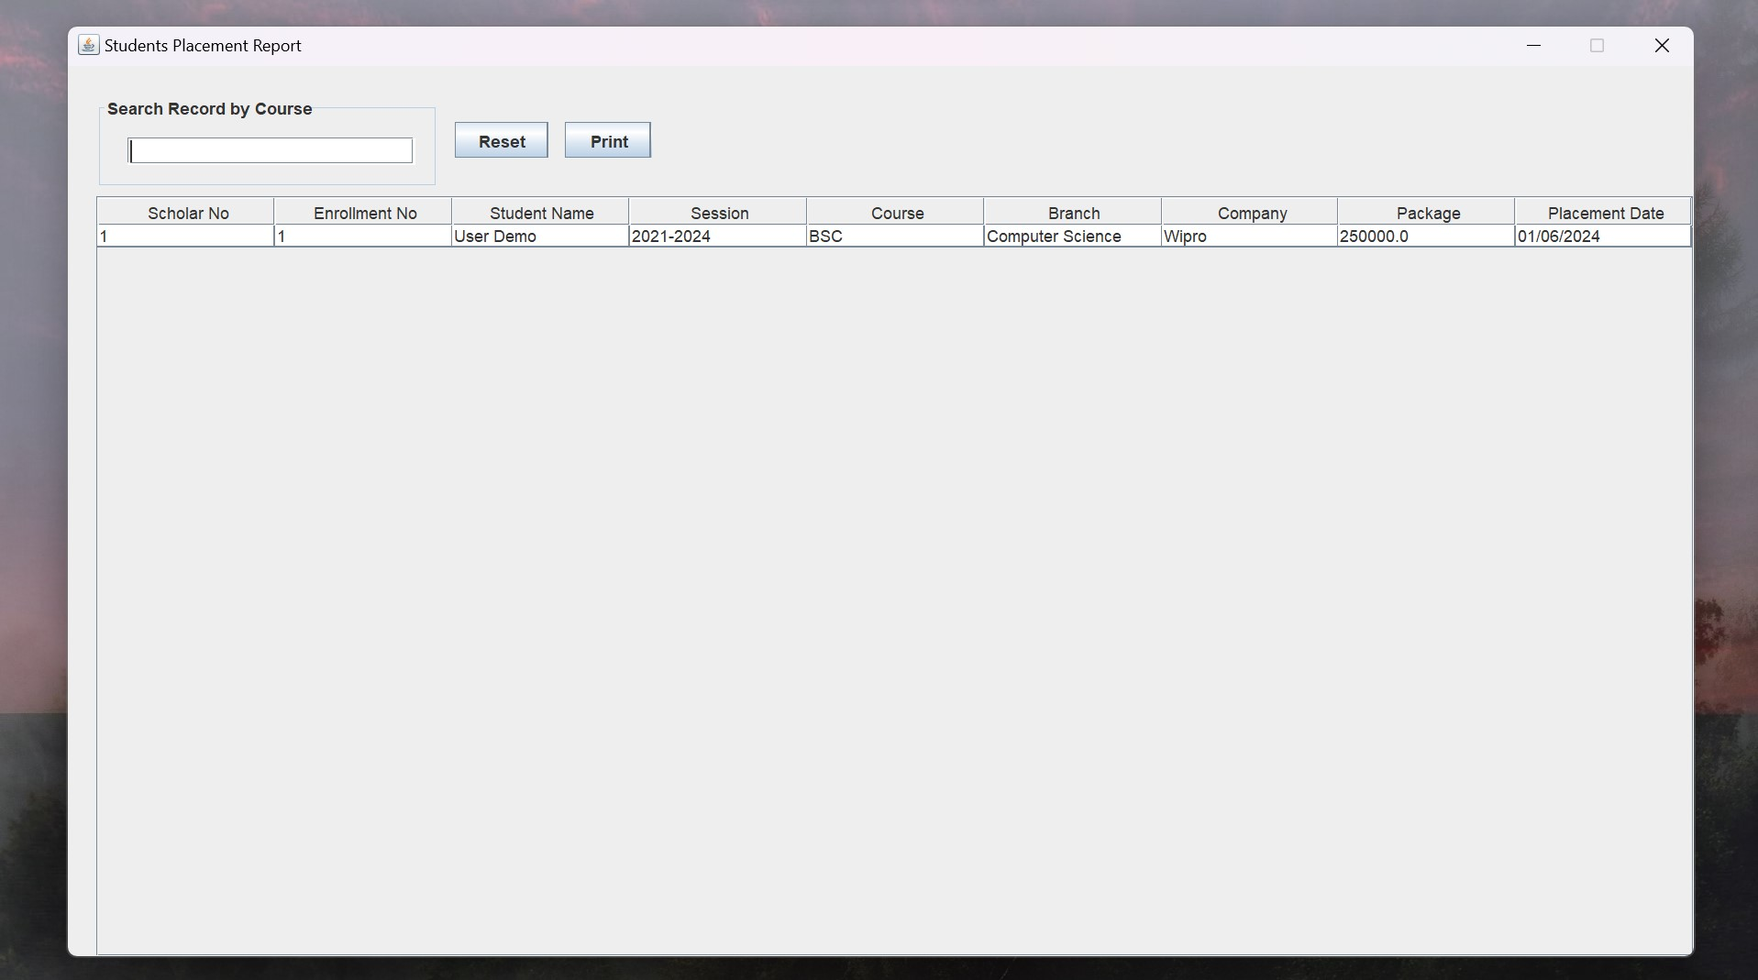
User Interface PLACEMENT REPORT PAGE

Slide 26
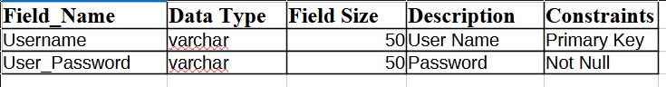
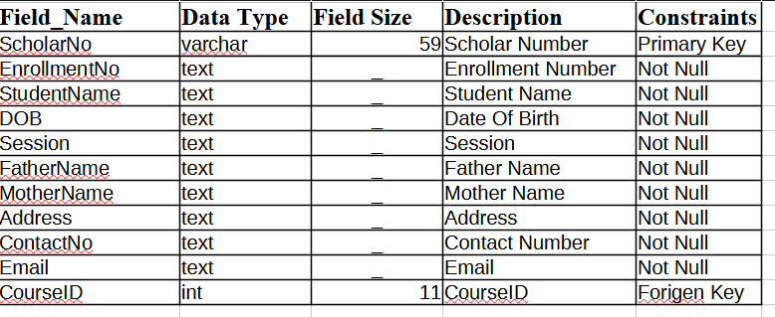
TABLES ADMIN,STUDENT
ADMIN
STUDENT

Slide 27
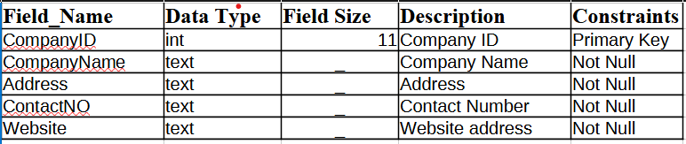
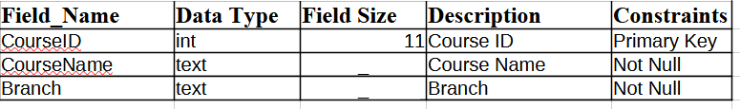
TABLES COMPANY,COURSE
COMPANY
COURSE

Slide 28
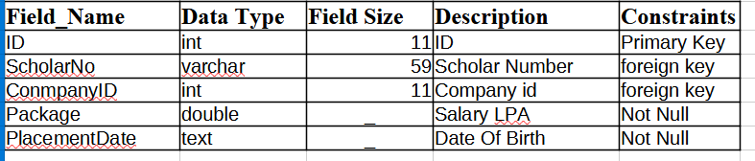
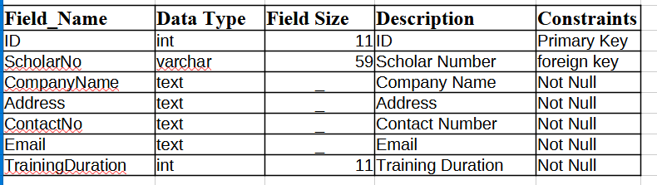
TABLES TRAINING AND PLACEMENT
Studentplacement
Studenttraining

Slide 29
ADVANTAGES & DISADVANTAGES
Advantages:
Streamlined Process
Improved Accessibility
Enhanced Efficiency
Improved Candidate Experience
Disadvantages:
Initial investment
User Adoption
Maintenance and Updates
Dependency on technology

Slide 30
FUTURE SCOPE
Artificial Intelligence and Machine Learning:
Predictive Analytics
Blockchain Technology
Virtual Reality (VR) and Augmented Reality (AR)
Global Networking and Opportunities
Data Visualization and Reporting
Mobile Accessibility

Slide 31
CONCLUSION
CTPCMS offers numerous advantages in terms of efficiency, accessibility, and effectiveness, it is essential to acknowledge and address potential challenges such as initial investment, integration complexities, user adoption, maintenance requirements, security risks, and dependency on technology. By implementing appropriate strategies to mitigate these challenges and capitalize on the benefits of CTPCMS, educational institutions can realize significant improvements in the placement process, student outcomes, and institutional reputation.

Slide 32


